Slide 1
^{Air quality monitor :} Enhancing environmental awareness
Team members:
Pavin r
Moha prasath U s
Balaji K p
Jeevanandham s
Ravi Krishnan k

Slide 2
Content :
Introduction
Types of Air Quality Monitor
Applications
How it works
Benefits
Conclusion

Slide 3
Introduction :
Air quality monitoring is an important tool for improving air quality, protecting public health,and ensuring compliance with regulations.
The purpose of air quality monitoring is to assess the level of pollution realtion to air quality standards.The target is to achieve clean and breathable air.

Slide 4
Types of air quality monitor :
Portable air quality monitor
Stationary air quality monitor
Indoor air quality monitor
Wearable air quality monitor
Remote sensing and satellite based monitors
Low cost air quality monitor sensors
Laboratory analyzers

Slide 5
Applications :
Detect carbon dioxide levels, noxious gases and pollutants
Measure and report on air quality in real time
Instant alerts when threshold values of different gases are reached
Automated, customisable reporting
Indoor and outdoor air quality monitor
Early gas leak detection
Low – Cost
Compact in size

Slide 6
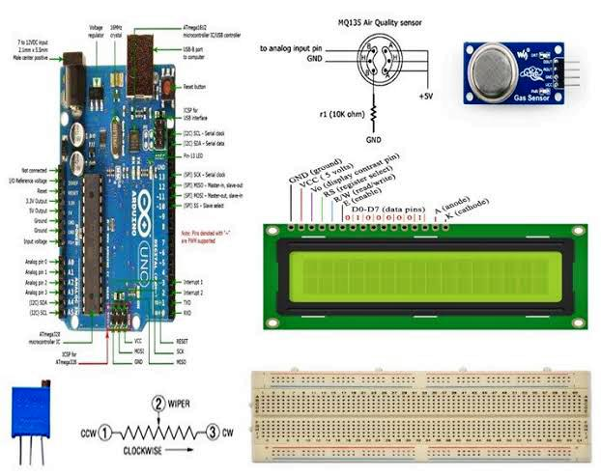
How it works:
Sampling the air by drawing air into the monitor through an inlet or sensor chamber
Detecting the pollutant, light scattering or operation methods are commonly used. Light scattering sensors emit a light source (eg. laser or LED )through air and detectors measure the light to estimate particulate matter
The sensors generate electrical signals or data of the pollutant concentration and collects the data The collected data is processed using algorithms and calibration factors to ensure accuracy It displays the real-time measurements to the users

Slide 7
Benefits:
Health benefits :
This can help people take precautions early, especially those with respiratory conditions, to avoid exposure to harmful pollutants
Indoor air quality monitor helps individuals maintain a healthier living and working environment
Valuable for medical research and epidemiology studies
Environmental benefits :
The protection of the environment by detecting and tracking pollution sources
Helps to identify specific pollution sources such as industrial emissions or traffic related pollution

Slide 8
Conclusion:
An Iot based air pollution monitoring system is a revolutionary solution that can provide accurate and real-time data about the air quality in a particular area and protecting the environment and human health.

